Slide 1
DataStax Enterprise 6 Solution Day

Slide 2
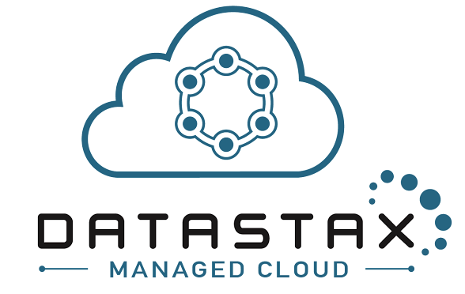
DataStax Managed Cloud
DSE on public cloud (AWS, Azure) for production workloads
24x7x365 coverage, lights-out management
System configuration and tuning to meet your-specific requirements
Architecture advisory services, guidance, and best practices
Focus on business innovation and accelerate time-to-market

Slide 3
Introducing DataStax Managed Cloud
A Fully Managed, Secure Architecture
DSE on AWS for production workloads
24x7x365 coverage, lights-out management – by the engineering and support experts at managing to scale
Optimized for your apps
Architecture advisory services, guidance, and best practices

Slide 4
Onboarding
Ramping you up for take-off
DataStax Solution Architect
Orients you to the cloud console and platform
Reviews your apps for platform, data model, and access patterns
Cluster
Tested and sized for right instances
Production provisioned
Alerting configured
Notes:
If you’re new to DataStax Managed Cloud or you’re an existing customer provisioning a new production environment, the DataStax Managed Cloud team and DataStax Professional Services will work with you to ensure our mutual success with your production cluster.
A DataStax Solution Architect will be engaged to orient you to the management console and platform, review the applications that will be running on the platform, and go over the proposed data model and access patterns to help identify difficult problems before they go into production.
The cluster will be tested and sized for the appropriate instance type and density, and finally the production cluster will be provisioned and alerting will be configured for the DataStax Managed Cloud platform to assume operational responsibility.

Slide 5
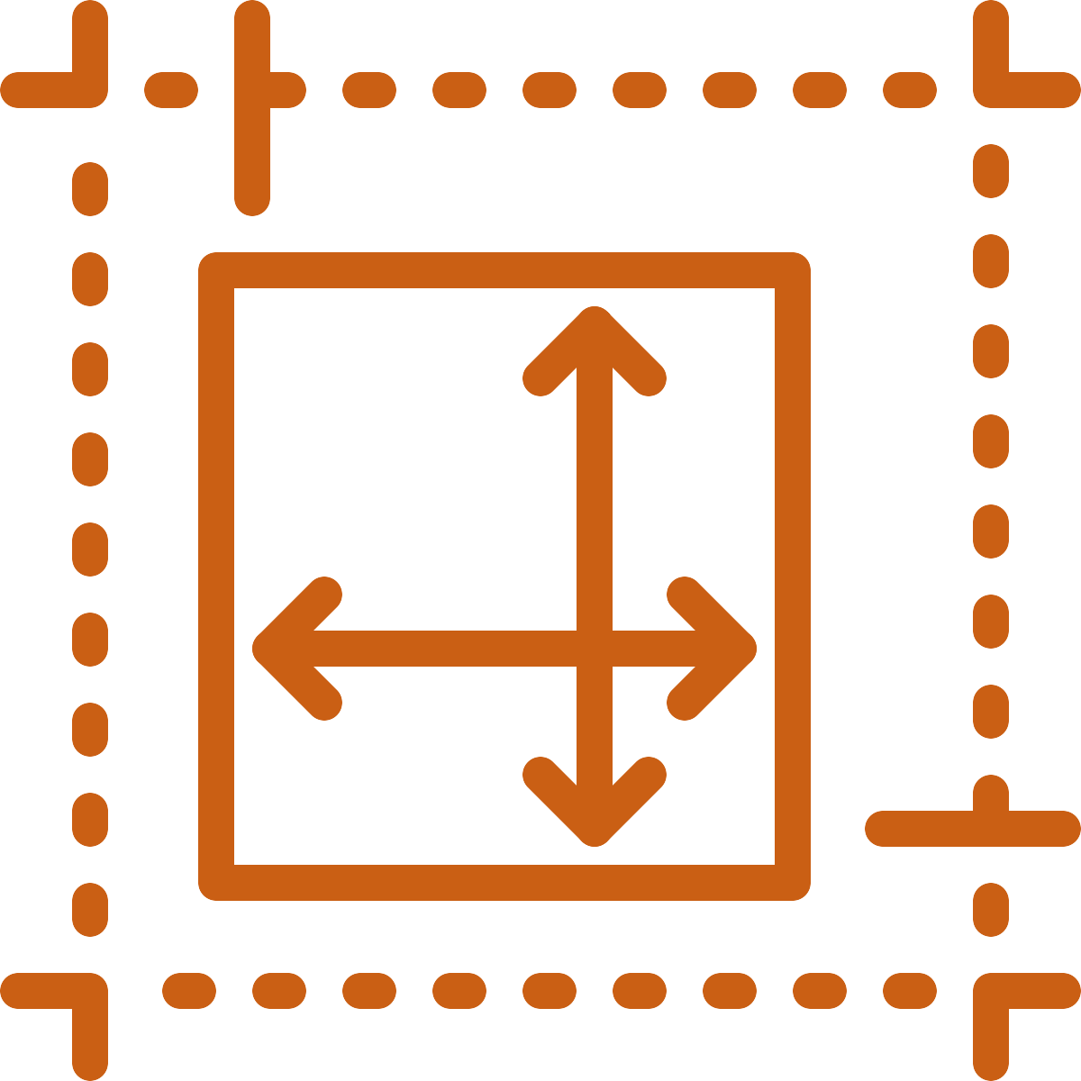
Provisioning
Custom Fit
Provisioning into your VPC
Environment setup, installation, and configuration
Production
Best-practices blueprints
Configured for optimal performance
Tuned to your apps, lifecycle-managed
Non-production (optional)
Ad-hoc, provisioning by end-user and lifecycle management via console or API
Notes:
DataStax Managed Cloud handles all DSE provisioning tasks, from cloud environment set-up installation and configuration. Clusters are provisioned into virtual private cloud environments that you own, and all data remains within your account at all times. All clusters are built according to best-practice blueprints and are configured for optimal performance for various cloud instance types. Production clusters are tuned to your specific applications and are lifecycle-managed from cradle to grave by DataStax professionals. Ad-hoc, end-user controlled provisioning and lifecycle management is an available option for non-production clusters, which can be driven through a web interface or can be consumed via a RESTful API which allows for integration with automated systems such as CI/CD frameworks.

Slide 6
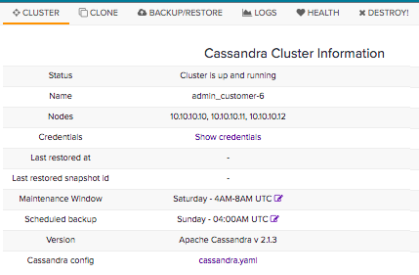
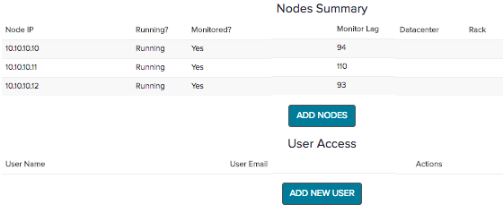
Cloud Console
Your ‘home base’ to view your cluster
View cluster metrics and logs
Easily submit a ticket on specific cluster
Console integrates with your systems via RESTful AP
Notes:
The management console is a web-based front end that is the primary user interface for the DataStax Managed Cloud platform. Through the management console, you can view cluster metrics and logs as well request support on specific clusters.
When you submit a ticket through the management console, there is no need to provide exhaustive details or diagnostic logs as the DataStax Managed Cloud team has direct access to the cluster configuration and logs. The management console also integrates with your automated management systems via a RESTful API.

Slide 7

Proactive intervention/alerting
Finding problems before they exist
Automated alerts against exceeded thresholds
Based on years of expertise
Avoiding issues through
Automated fixes
Engineer action
Fault-tolerance at multiple levels
Intervention still required for recovery – and handled for you
Bursting included
Notes:
Clusters are configured to alert the DataStax Managed Cloud platform to potential problems so that remediations can be attempted before availability or performance issues arise. In some cases, automated fixes are available. In other cases, an engineer will directly address a potential problem. Any distributed system must be fault-tolerant given the increased probability of failure as the number of components in the system increases. DSE is fault-tolerant at multiple levels, but requires operator intervention to return to a fully healthy state. DataStax Managed Cloud resolves failures on your behalf. Failed instances are replaced and any follow-up repair work is handled as part of the replacement process to restore the cluster to a fully healthy state. In addition to monitoring for failures, we also keep an eye on the system utilization that is driven by your production workload and will automatically expand the cluster to accommodate workload spikes. This is what we call a burst event, and it is included in your subscription. When a burst event happens, we will follow up with you to understand the nature of the event. Transient workload spikes will often be covered by the included burst capacity, but in the case of a need for permanent cluster expansion, we will work with you and your account team on a strategy to size up the DataStax Managed Cloud cluster in the bursted state.

Slide 8

Backups & restores
Restore with confidence
Protect against
Data loss due to application bugs
Operator error
Backups moved to cloud object storage for easy recovery
Scheduled restore exercises – and restore on request
Notes:
Even though DSE is a replicated distributed system, backups are required to protect it from data loss due to application bugs or operator error. A number of backup schedules and strategies are available for production and non-production clusters. Backups can be configured at cluster creation time and modified at any later point. Backup files are moved off of the cluster instances into cloud object storage, which can then be used for restore operations or to clone a production cluster snapshot into a non-production environment. Backups are only valuable if they can actually be used when they’re needed. The DataStax Managed Cloud platform will coordinate with you to perform restore exercises from backups so that you can be confident your backups will serve their purpose in an emergency. Restores can be requested at any time via the management console.

Slide 9

Upgrades support/service requests
Easy upgrades
Aggressive bug fixes, if needed
Leveraging DataStax engineering for fast time to resolution
The latest and greatest features – that fit your schedule
9
© 2017 DataStax, All Rights Reserved. DataStax is a registered trademark of DataStax, Inc. and its subsidiaries in the United States and/or other countries. Apache Cassandra, Apache, Spark, and Cassandra are trademarks of the Apache Software Foundation or its subsidiaries in Canada, the United States and/or other countries.
Notes:
As new versions of DSE are released, the DataStax Managed Cloud team will work with you to upgrade clusters on your behalf on a schedule that accommodates production cluster workloads. In general, we will schedule bug-fix releases to be rolled out aggressively, particularly in the case of potential security concerns. Feature releases can be rolled out on a more flexible basis.

Slide 10
Thank you

